Slide 1
Data Journalism
DELETE BEFORE UPLOAD
Individual Assignment • Template

Slide 2
This slide deck contains the instructions and the template for your first assignment.
You should first download this slide deck (.pptx)
Then, start editing it accordingly, as instructed in each slide.
Once you are done with all the assignment, you should delete the first slide, this present slide and any other slide with the “DELETE” icon at the top. This way, in the end, the final deck will contain only slides in which you, yourself, have added content.
Upload your slide deck to appropriate course page.
DELETE BEFORE UPLOAD

Slide 3
Data Journalism
Student name: REPLACE WITH YOUR NAME
Student ID: REPLACE WITH YOUR ID
Student e-mail address: REPLACE WITH YOUR E-MAIL ADDRESS

Slide 4
If you follow through with the instructions, you will start from a dataset and will output two data visualizations to communicate insights from such dataset. To start, choose one of the following datasets for your project and export the data in the desired format (likely Excel or .CSV)
ISTAT - data on crimes in Italy Link to data here. (beware of nested data. For example, “homicides for theft or robbery” is also counted as part of “intentional homicides”, or “car-theft” is also counted among “thefts”. Decide first on the level of granularity you want and then deal with the data accordingly).
ISTAT - Public university professors by sex and faculty of teaching Link to data here
ISTAT - Prison capacity and number of prisoners Link to data here (The variable “prisoners held in institutions for adults (per hundred of capacity)” indicated how full the prison is in relation to its capacity. a value of 100% would mean that the prisons are completely filled. Any value higher than this indicated that the prison is over-populated in relations to its regulatory capacity).
ISTAT - Tourism monthly data Link to data here
ISTAT - Households and Internet Access Link to data
NOTE: depending on the angle and dataset you use, you might need some basic stats on the population of Italian provinces. You can find Italy’s population data here
DELETE BEFORE UPLOAD

Slide 5
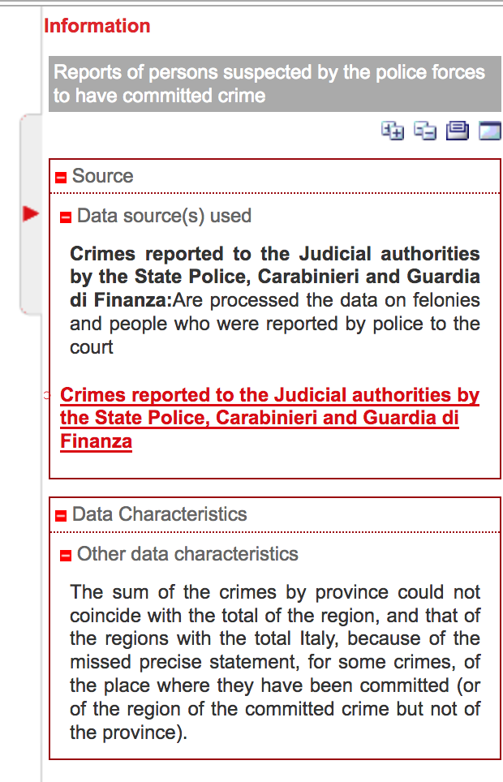
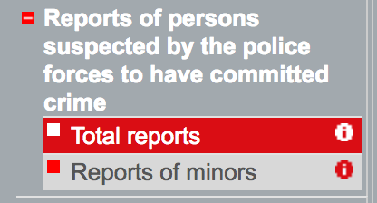
A tip: for each dataset, you should click on the round i icon next to the dataset name or next to the name of some variables. This will open up an information panel on the right, with metadata and information about the publisher, the variables, the methodology, etc. Example: screenshot from the first ISTAT dataset listed in the previous page
DELETE BEFORE UPLOAD
Information icon location, examples
Metadata panel, example ->

Slide 6
About Data
Replace all of the following text with your own: Write down your initial considerations about the data
Which dataset did you choose
What license is it shared with and what does this mean for the use you intend to do with it
Do you think there will be any concerns with the quality and completeness of the data? (Think of: ambiguous coding of the data, limitations with the data collection methodology, etc. Look at the metadata information to help you out in this.)
Do you anticipate you will need to perform any data cleaning operations? If so, what tasks and how did you perform them?

Slide 7
Insights from the Data
Replace all of the following text with your own: Write down (bullet points are ok) what are the main insights you derived from your dataset and what type of data analysis operation you performed in order to reach these insights. From this insights, pick the ones you think are more interesting and can be conveyed using two data visualizations.

Slide 8
You are free to choose any tool you want to produce the 2 data visualization that you should include in the following slides.The only constraint is that you should use two different tools, one for each visualization. We recommend you pick them from the list of those suggested on the Slide Deck “2d. Visualizing and Presenting Data”. All of these tools are accessible to beginners, but the ones with the most approachable learning curve are probably DataWrapper and Flourish.
To include the visualizations in the following slides, simply attach an image screenshot of your work and add any titles/text you deem necessary. You may also provide links to your actual works if they are hosted online and are interactive. The two visualizations can be part of two separate stories or be part of the same narrative. In any case, make sure you do add text that puts the visualizations in context, so that they are part of an interesting storyline. You can add an extra slide or two, if you have a lot of text, but make sure you stay within reasonable limits (max. 4 slides for story and visualizations)
DELETE BEFORE UPLOAD

Slide 9
Add your first data visualization + story, and delete this text

Slide 10
Add your second data visualization + story, and delete this text

Slide 11
A final step, before you publish: pick a license to share your work and modify the following slide accordingly. Just note that all material on SlideWiki requires a Creative Commons license. You can use Creative Commons’ license picker to generate the text for your licence: https://creativecommons.org/choose/
DELETE BEFORE UPLOAD

Slide 12
Slides are shared with the following license:
'TITLE OF YOUR WORK' by YOUR NAME, is licensed under a NAME OF YOUR CHOSEN CREATIVE COMMONS LICENSE, FOR EXAMPLE CC-BY-SA
LICENCE

